Slide 1

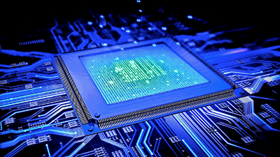
Introduction to Digital Systems
EGR 226
Lecture_6
Dr. Nabeeh Kandalaft EGR226 Grand valley State University

Slide 2
Topic for today’s lecture
describe the serial communication link between MSP432 on Launchpad and the PC
describe the difference between asynchronous and synchronous communication
describe the Inter-Integrated Circuit Bus (I2C)
the bus architecture
the protocol for messaging between master and slave
write C code to implement data transfer between the MSP432 and an I2C peripheral
Dr. Nabeeh Kandalaft EGR226 Grand valley State University

Slide 3
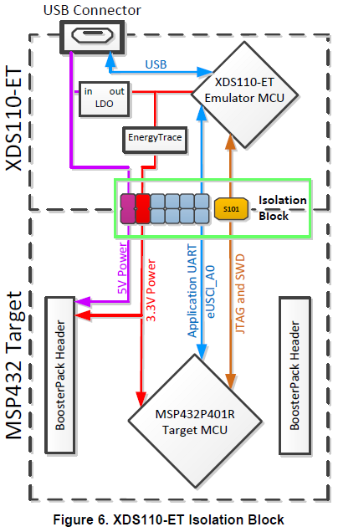
Launchpad Serial Communication
USB to serial converter hardware in an ARM M4 chip also runs debug program
(you can also buy devices that perform serial to USB conversion)
Serial receive (RX) and transmit (TX) bit streams
Connected to eUSCI_A0 on MSP432 (P1.2, P1.3)
Used to
communicate between MSP432 program and PC terminal emulator
Dr. Nabeeh Kandalaft EGR226 Grand valley State University

Slide 4

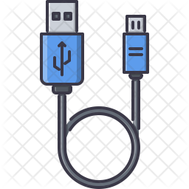
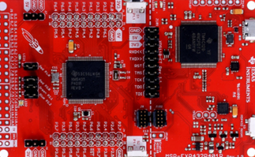
Using the Backchannel UART for printf to PC
If you use printf ( ) in your code without setting it up for channeling it through the UART, the character strings will be viewable on the debug console.
The compiler/debugger adds a breakpoint right after the code converting the character strings finishes, and then pull the characters out the memory via JTAG and displays it on the console (when the buffer is flushed with \n).
To get characters to route to the PC com port, we need to override fputc() and fputs() of the RTS (Run-Time-Support) library functions in a new file
http://43oh.com/2015/05/how-to-add-printf-support-for-the-msp432-launchpad-serial-port
You need to convert the old style EUSCI_A0_MODULE to EUSCI_A0_BASE
You also need a terminal emulator program such as Termite http://www.compuphase.com/software_termite.htm
to capture characters from the keyboard and send them to the serial port driver for the USB port connected to the Launchpad
Dr. Nabeeh Kandalaft EGR226 Grand valley State University

Slide 5
Universal Serial Bus (USB)
An industry standard developed in the mid-1990s
defines the cables, connectors and communications protocols
used for communication and power between computers and electronic devices.
USB has effectively replaced a variety of earlier interfaces, such as serial and parallel ports.
PCs automatically detects the peripheral and configures the necessary software (hot pluggable).
USB lets the PC automatically sense the power that's required and deliver it to the device
Dr. Nabeeh Kandalaft EGR226 Grand valley State University

Slide 6
Microcontroller Communications
Peripheral devices in embedded systems are often connected to the microcontroller as memory-mapped I/O devices.
One common way to do this is connecting the peripherals to the microcontroller parallel address and data busses.
This works well for peripherals integrated on the microcontroller chip.
This would result in lots of traces on the PCB and additional ‘glue logic’ to decode the address bus for off-chip peripherals.
To spare microcontroller pins and make the PCBs simpler (lower the costs) –
Philips labs invented the ‘Inter-Integrated Circuit’ (I²C) protocol that only requires 2 wires for connecting all external peripherals to a microcontroller.
Now a published standard, the original specification defined a bus speed of 100 kbps, but now it supports speeds up to 5 Mbps for fast peripherals.
Dr. Nabeeh Kandalaft EGR226 Grand valley State University
Notes:
Glue Logic
In electronics, glue logic is the custom logic circuitry used to interface a number of off-the-shelf integrated circuits. This is often achieved using ordinary (cheap) 7400- or 4000-series components. In more complex cases, programmable logic devices like a CPLD or FPGA might be used.

Slide 7
Asynchronous Serial Communications
A UART with TX and RX lines, is called “asynchronous” (not synchronous) because data can be sent at random times.
A lot of overhead and complex hardware to control and sync baud rates is required to send and receive data.
The receiver and transmitter must have clock rates that are close to one another to prevent sync errors.
TX
RX
Extra bits (start and stop bits) added to each byte help the receiver sync up to data as it arrives
Data bits
1
1
0
1
0
0
0
1
Idle or
Next byte
idle
Start
bit
stop
bit
Dr. Nabeeh Kandalaft EGR226 Grand valley State University
Notes:
Glue Logic
In electronics, glue logic is the custom logic circuitry used to interface a number of off-the-shelf integrated circuits. This is often achieved using ordinary (cheap) 7400- or 4000-series components. In more complex cases, programmable logic devices like a CPLD or FPGA might be used.

Slide 8
synchronous Serial Communications
A “synchronous” data bus, which means that it uses separate lines for data and a “clock” that keeps both sides in sync.
One reason I²C is so popular is that only two lines are required to talk to many devices.
CLOCK
DATA
CLOCK
DATA
Idle or
Next byte
When the receiver detects the clock edge, it will immediately look at the data line to read the next bit.
One type of synchronous serial bus is the Inter Integrated Circuit (IIC or I²C) bus.
Idle
CLOCK
0 1 2 3 4 5 6 7
DATA
1 0 1 0 0 0 1 1
Dr. Nabeeh Kandalaft EGR226 Grand valley State University
Notes:
Glue Logic
In electronics, glue logic is the custom logic circuitry used to interface a number of off-the-shelf integrated circuits. This is often achieved using ordinary (cheap) 7400- or 4000-series components. In more complex cases, programmable logic devices like a CPLD or FPGA might be used.

Slide 9

The Inter-Integrated Circuit (I2C) Protocol
The I2C-bus has become a de facto world standard that is now implemented in over 1000 different ICs and licensed to more than 50 companies*
Nearly every electronics system includes:
Some intelligent control, usually a single-chip microcontroller
General-purpose circuits like LCD drivers, remote I/O ports, RAM, EEPROM, or data converters
Application-oriented circuits such as digital tuning and signal processing circuits for radio and video systems
I²C was developed by Philips to provide a simple bi-directional 2-wire bus for efficient inter-IC control.
Dr. Nabeeh Kandalaft EGR226 Grand valley State University
Notes:
Glue Logic
In electronics, glue logic is the custom logic circuitry used to interface a number of off-the-shelf integrated circuits. This is often achieved using ordinary (cheap) 7400- or 4000-series components. In more complex cases, programmable logic devices like a CPLD or FPGA might be used.

Slide 10

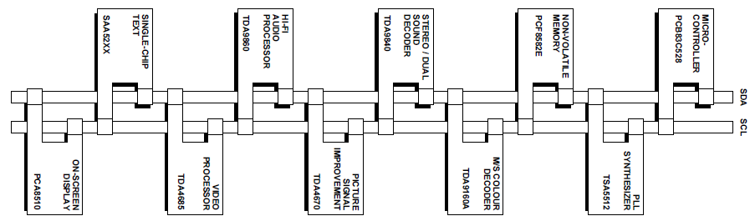
Example I2C System
TV set
Features:
Only two bus lines: serial data line (SDA) and a serial clock line (SCL)
Each device is software addressable by a unique address
A master device (usually MCU) controls the bus and talks to slave devices
Serial, 8-bit oriented, bi-directional data transfers at rates up to 100 kbit/s, 400 kbit/s, or 5 Mbit/s
A large number of ICs can be connected to the same bus
Dr. Nabeeh Kandalaft EGR226 Grand valley State University
Notes:
Glue Logic
In electronics, glue logic is the custom logic circuitry used to interface a number of off-the-shelf integrated circuits. This is often achieved using ordinary (cheap) 7400- or 4000-series components. In more complex cases, programmable logic devices like a CPLD or FPGA might be used.

Slide 11
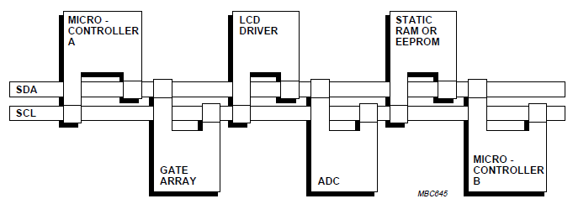
Benefits of I2C
Simple 2-wire bus minimizes interconnections so ICs have fewer pins, fewer PCB tracks, smaller and less expensive PCBs
Integrated I2C-bus protocol eliminates the need for address decoders and ‘glue logic’
I2C-bus compatible ICs are widely available
Easy to add new features to equipment, simply unclip the outdated IC from the bus and clip on its successor
Multi-master capability of the I2C-bus allows rapid testing and alignment of end-user equipment via external connections
(design for testability)
Dr. Nabeeh Kandalaft EGR226 Grand valley State University
Notes:
Glue Logic
In electronics, glue logic is the custom logic circuitry used to interface a number of off-the-shelf integrated circuits. This is often achieved using ordinary (cheap) 7400- or 4000-series components. In more complex cases, programmable logic devices like a CPLD or FPGA might be used.

Slide 12
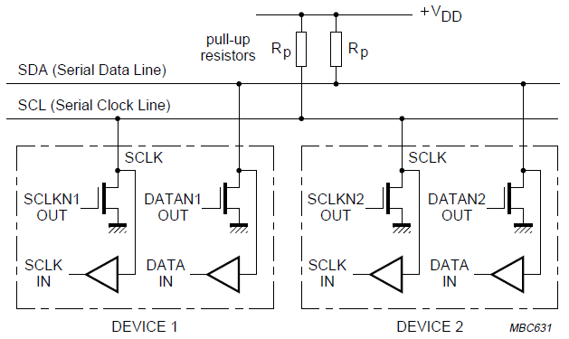
I2C Bus Protocol
The master and slave cannot drive a signal on the bus, only pull the signal down to 0V for logic 0 and do nothing for a logic 1 during the clock interval
High R will limit current, but, combined with C will create longer rise time
Typical value
2-10K
Dr. Nabeeh Kandalaft EGR226 Grand valley State University
Notes:
Glue Logic
In electronics, glue logic is the custom logic circuitry used to interface a number of off-the-shelf integrated circuits. This is often achieved using ordinary (cheap) 7400- or 4000-series components. In more complex cases, programmable logic devices like a CPLD or FPGA might be used.

Slide 13
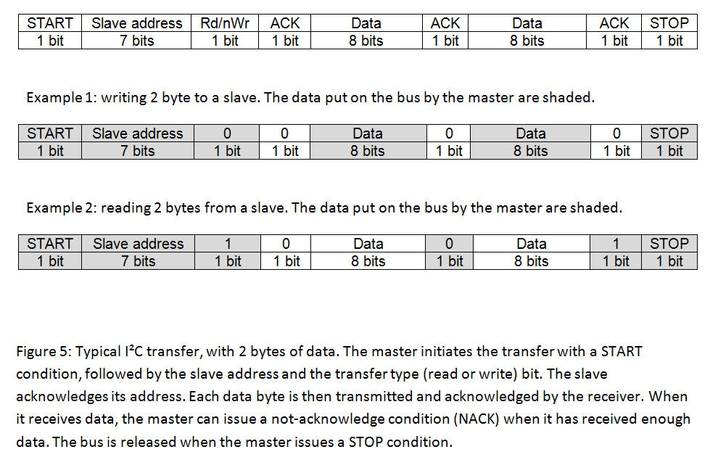
I2c transaction

Slide 14
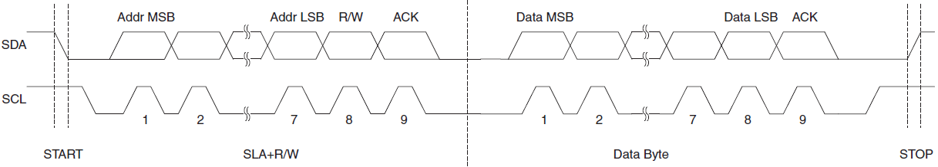
I2C Bus Protocol
The master is initially in master transmit mode
it sends a start bit (SDA pulled low, then SCL)
followed by the 7-bit address of the slave
followed by a single bit representing a write(0) to or read(1) from the slave.
If the slave exists at that address on the bus then it will respond with an ACK bit (active low).
The master then continues in either transmit or receive mode (according to the read/write bit sent with the slave address), and the slave continues in a complementary mode (receive or transmit).
Dr. Nabeeh Kandalaft EGR226 Grand valley State University
Notes:
Glue Logic
In electronics, glue logic is the custom logic circuitry used to interface a number of off-the-shelf integrated circuits. This is often achieved using ordinary (cheap) 7400- or 4000-series components. In more complex cases, programmable logic devices like a CPLD or FPGA might be used.

Slide 15
I²C Bus Protocol
The address and the data bytes are sent most significant bit first.
A stop bit is indicated by a low-to-high transition of SDA with SCL high.
All other transitions of SDA take place with SCL low, then SCL is pulsed (released to be pulled up) after transitions are stable.
If the master wishes to write to the slave then it sends a byte while looking for the slave to send an ACK bit,
then sends another byte and looks for another ACK or sends the STOP signal.

Slide 16
I²C Bus Protocol
If the master wishes to read from the slave (bit R/W=1),
then it looks for a byte on SDA from the slave,
and sends an ACK to the slave when it is received.
When the master sends an ACK bit, the slave sends another byte.
When the master has received the last desired byte, it sends no ACK.
The master then either ends transmission with a STOP bit, or it may send another START bit
if it wishes to retain control of the bus for another transfer (a "combined message").

Slide 17
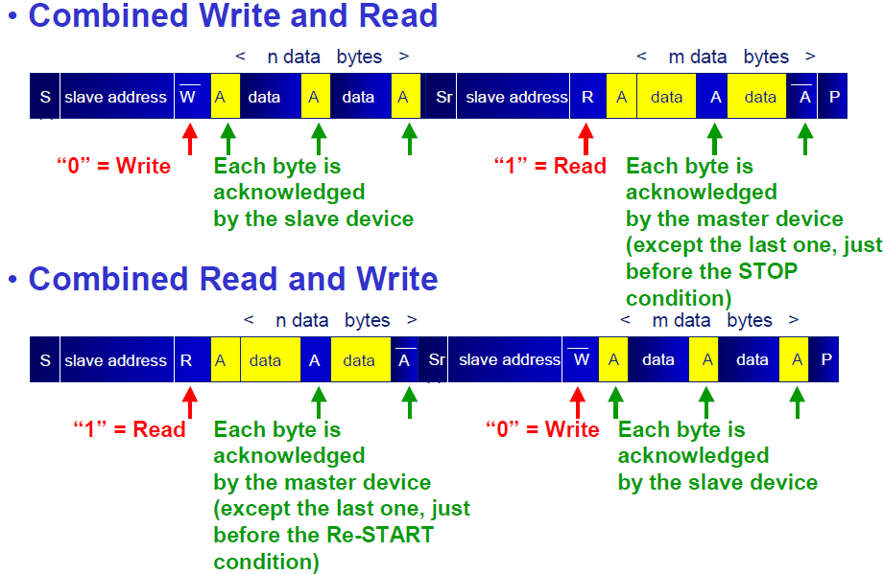
I²C Protocol
I2C Protocol

Slide 18
I2C Protocol – The Acknowledge
The master generates all clock pulses, including the acknowledge ninth clock pulse.
The acknowledge bit allows the receiver to signal the transmitter that the byte was successfully received and another byte may be sent.
The transmitter releases the SDA line during the acknowledge clock pulse so the receiver can pull the SDA line LOW
When SDA remains HIGH during this ninth clock pulse, this is defined as the Not Acknowledge signal.
The master can then generate either a STOP condition to abort the transfer, or a repeated START condition to start a new transfer.

Slide 19
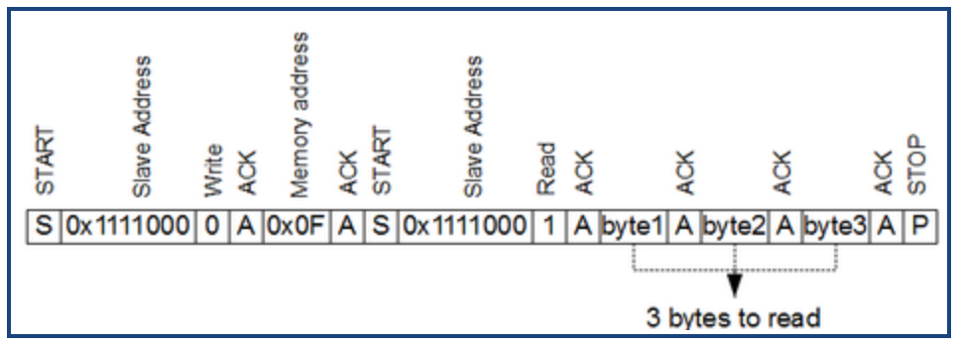
Communications - I2C
I²C can send and receive multiple bytes inside single packet.
This is handy for instance to write or read memory.
e.g., read 3 bytes from EEPROM memory address 0x0F, EEPROM slave address is 0×1111000.
First the Master has to write in order to select initial memory address.
Then send start signal again in order to initiate Master read mode.
Then after reading all bytes, it frees line by sending a STOP signal.

Slide 20
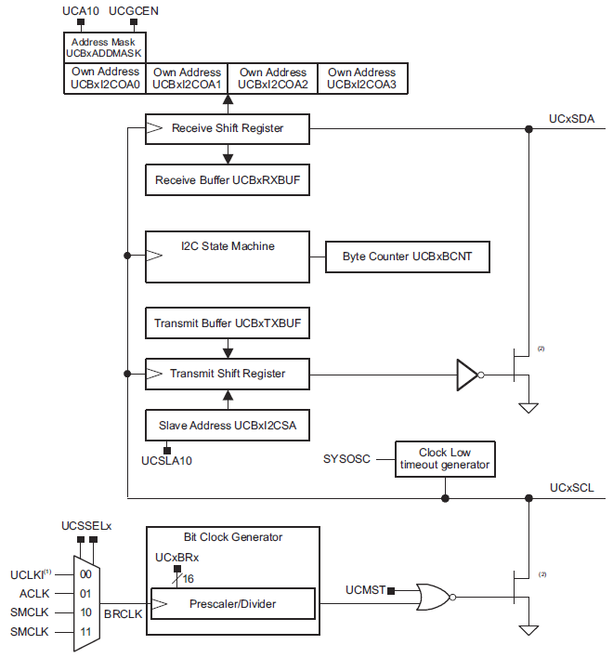
eUSCI_B in I²C Mode
4 ports of I²C are available on the MSP432.
Shift registers interface with buffers (memory mapped) for receive/transmit
State machine controls signaling protocol
Can be bus Master or Slave

Slide 21
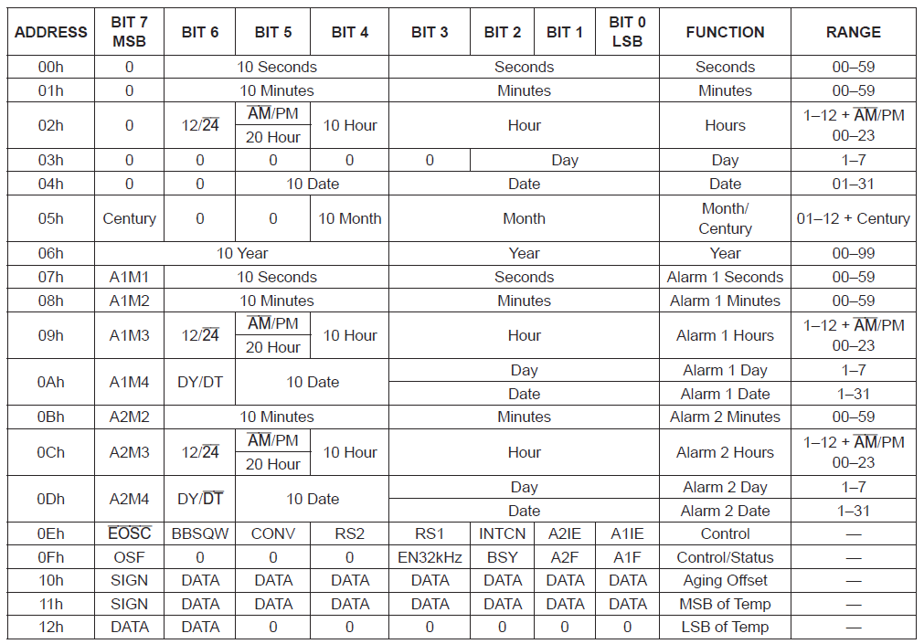
I²C Interface to Real Time Clock
From the data sheet for the DS3231

Slide 22
Communications - I2C
#include "msp.h"
#define S1 BIT1
#define SLAVE_ADDRESS 0x48
char TXData[10] = "RGBBGRBGGR";
int i = 0;
void main(void){
WDT_A->CTL = WDT_A_CTL_PW | WDT_A_CTL_HOLD;
P1->DIR &= ~S1;
P1->REN = S1;
P1->OUT = S1;
P1->IE = S1;
P1->IES = S1;
P1->IFG = 0x00;
P1->SEL0 |= BIT6 | BIT7; // P1.6 and P1.7 as UCB0SDA and UCB0SCL
EUSCI_B0->CTLW0 |= EUSCI_B_CTLW0_SWRST; // Hold EUSCI_B0 module in reset state
EUSCI_B0->CTLW0 |= EUSCI_B_CTLW0_MODE_3|EUSCI_B_CTLW0_MST|EUSCI_B_CTLW0_SYNC;
EUSCI_B0->CTLW0 |= EUSCI_B_CTLW0_UCSSEL_2; // Select SMCLK as EUSCI_B0 clock
EUSCI_B0->BRW = 0x001E; // Set BITCLK = BRCLK / (UCBRx+1) = 3 MHz / 30 = 100 kHz
EUSCI_B0->I2CSA = SLAVE_ADDRESS;
EUSCI_B0->CTLW0 &= ~EUSCI_B_CTLW0_SWRST; // Clear SWRST to resume operation
NVIC->ISER[1] = 0x00000008; // Port P1 interrupt is enabled in NVIC
NVIC->ISER[0] = 0x00100000; // EUSCI_B0 interrupt is enabled in NVIC
__enable_irq(); // All interrupts are enabled
Master transmit code

Slide 23
Communications - I2C
while (EUSCI_B0->CTLW0 & EUSCI_B_CTLW0_TXSTP);
EUSCI_B0->CTLW0 |= EUSCI_B_CTLW0_TR | EUSCI_B_CTLW0_TXSTT;
SCB->SCR |= SCB_SCR_SLEEPONEXIT_Msk; // Sleep on exit
__sleep(); // enter LPM0
}
void EUSCIB0_IRQHandler(void){
uint32_t status = EUSCI_B0->IFG; // Get EUSCI_B0 interrupt flag
EUSCI_B0->IFG &=~ EUSCI_B_IFG_TXIFG0; // Clear EUSCI_B0 TX inter. flag
if(status & EUSCI_B_IFG_TXIFG0){ // Check if transmit interrupt occurs
EUSCI_B0->TXBUF = TXData[i++%10]; // Load current TXData value to transmit buffer
EUSCI_B0->IE &= ~EUSCI_B_IE_TXIE0;} // Disable EUSCI_B0 TX interrupt
}
void PORT1_IRQHandler(void){
uint32_t status = P1->IFG;
P1->IFG &= ~S1;
if(status & S1) EUSCI_B0->IE |= EUSCI_B_IE_TXIE0; // Enable EUSCI_A0 TX interrupt
}

Slide 24
Communications - I2C
#include "msp.h"
#define LED2_RED BIT0
#define LED2_GREEN BIT1
#define LED2_BLUE BIT2
#define SLAVE_ADDRESS 0x48
char RXData;
void main(void){
WDT_A->CTL = WDT_A_CTL_PW | WDT_A_CTL_HOLD;
P2->DIR = LED2_RED|LED2_GREEN|LED2_BLUE;
P2->OUT = 0x00;
P1->SEL0 |= BIT6 | BIT7; // P1.6 and P1.7 as UCB0SDA and UCB0SCL
EUSCI_B0->CTLW0 |= EUSCI_B_CTLW0_SWRST; // Hold EUSCI_B0 module in reset state
EUSCI_B0->CTLW0 |= EUSCI_B_CTLW0_MODE_3|EUSCI_B_CTLW0_SYNC;
EUSCI_B0->I2COA0 = SLAVE_ADDRESS | EUSCI_B_I2COA0_OAEN;
EUSCI_B0->CTLW0 &= ~EUSCI_B_CTLW0_SWRST; // Clear SWRST to resume operation
EUSCI_B0->IFG &= ~EUSCI_B_IFG_RXIFG0; // Clear EUSCI_B0 RX interrupt flag
EUSCI_B0->IE |= EUSCI_B_IE_RXIE0; // Enable EUSCI_B0 RX interrupt
NVIC->ISER[0] = 0x00100000; // EUSCI_B0 interrupt is enabled in NVIC
__enable_irq(); // All interrupts are enabled
SCB->SCR |= SCB_SCR_SLEEPONEXIT_Msk; // Sleep on exit
__sleep(); // enter LPM0
}
Slave receive code

Slide 25
Communications - I2C
void EUSCIB0_IRQHandler(void){
uint32_t status = EUSCI_B0->IFG; // Get EUSCI_B0 interrupt flag
EUSCI_B0->IFG &=~ EUSCI_B_IFG_RXIFG0; // Clear EUSCI_B0 RX interrupt flag
if(status & EUSCI_B_IFG_RXIFG0){ // Check if receive interrupt occurs
RXData = EUSCI_B0->RXBUF; // Load current RXData value to transmit buffer
if (RXData == 'R') P2->OUT ^= LED2_RED; // Toggle P2.0 if 'R' is received
else if(RXData == 'G') P2->OUT ^= LED2_GREEN; // Toggle P2.1 if 'G' is received
else if(RXData == 'B') P2->OUT ^= LED2_BLUE;} // Toggle P2.2 if 'B' is received
}

Slide 26
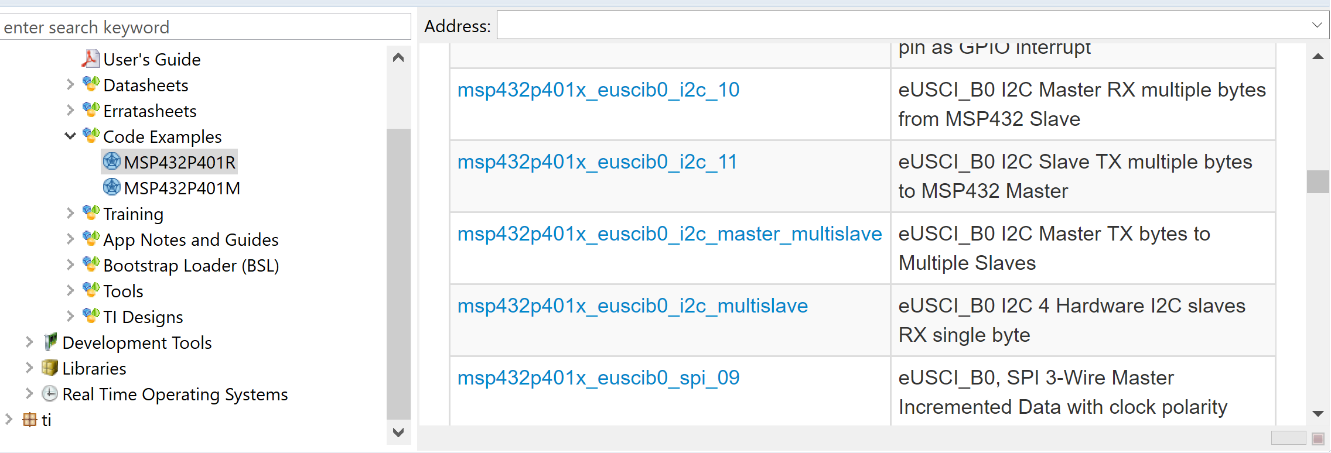
Other I2C sample code in code composer

Slide 27
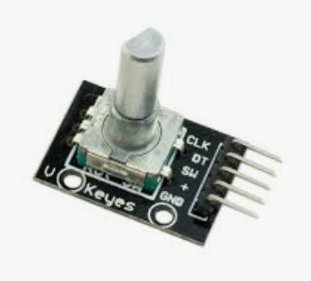
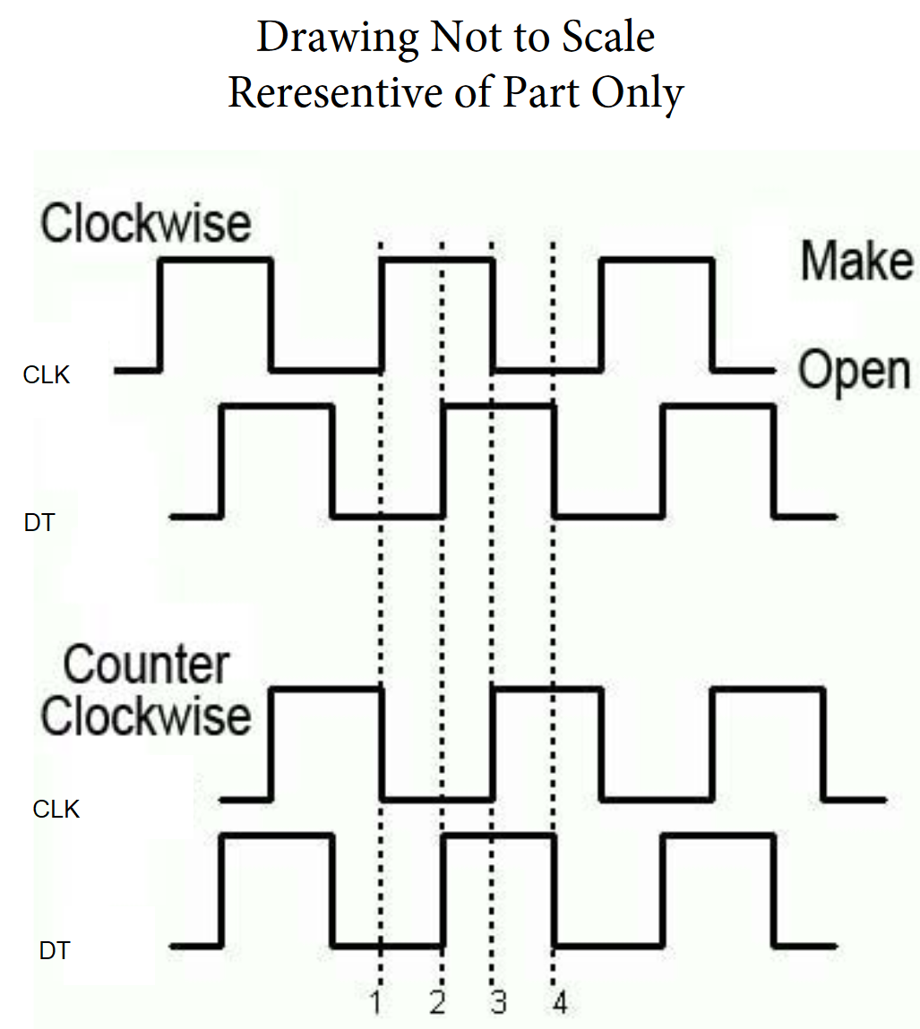
Rotary Encoder
Trigger on CLK
Check DT
IF DT high- CCW
IF DT low - CW

Slide 28
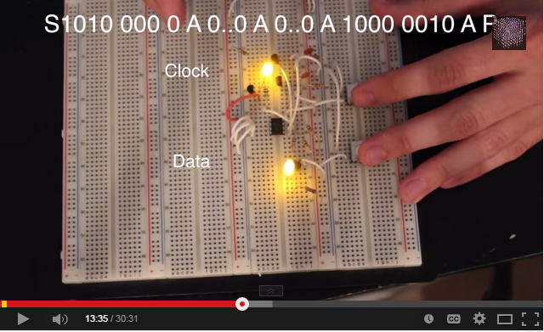
I²C Bit-Banged Without A Microcontroller!
“Bit Banging” means that instead using dedicated hardware, normal general purpose I/O pins are used to implement a protocol like I²C or SPI.
https://www.youtube.com/watch?v=8ZYMrcHm91s
At 7:20 gets interesting

